Slide 1
Parallelized Algorithm for Persistent Feasibility in Linear Systems with Multiple, External Switching Signals
Richard Arlen Hall, Dr. Leila Bridgeman
2022 – IEEE CDC

Slide 2
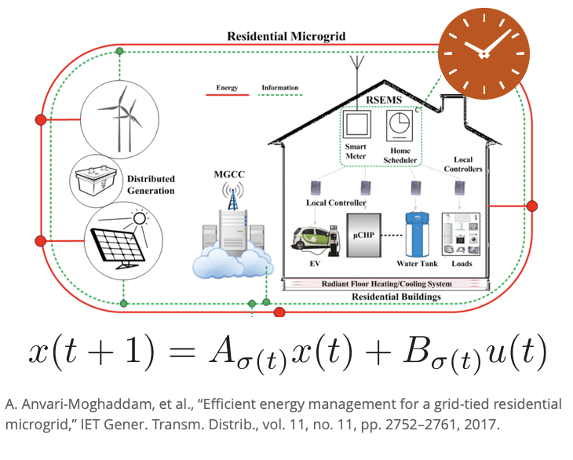
Introduction
Example: Microgrids
Objective: Regulate power storage, generation, and usage in microgrid.
Challenge: Limited resources could lead to loss of power.

Slide 3
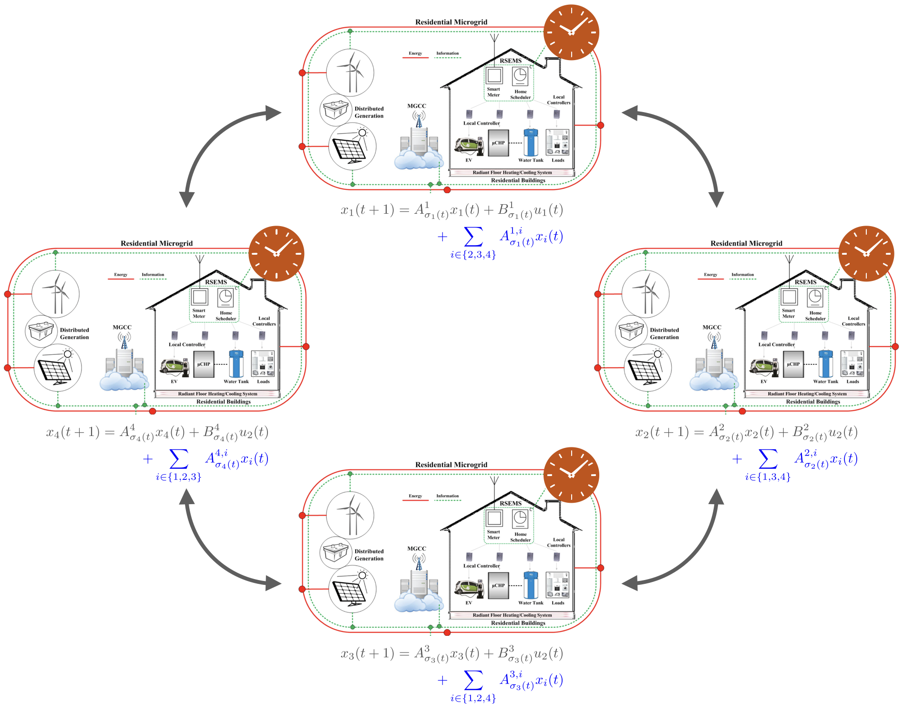
Introduction
Example: Microgrids
Objective: Regulate power storage, generation, and usage in microgrid.
Challenge: Limited resources could lead to loss of power.
Solution: Connect multiple microgrids together.
Challenge: Curse of dimensionality.
?

Slide 4
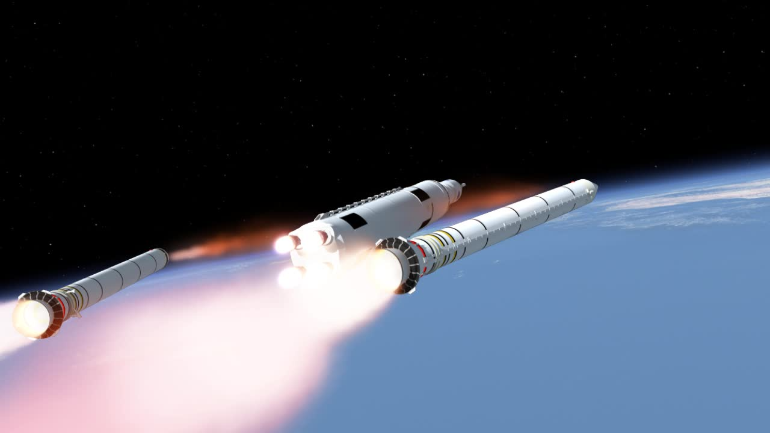
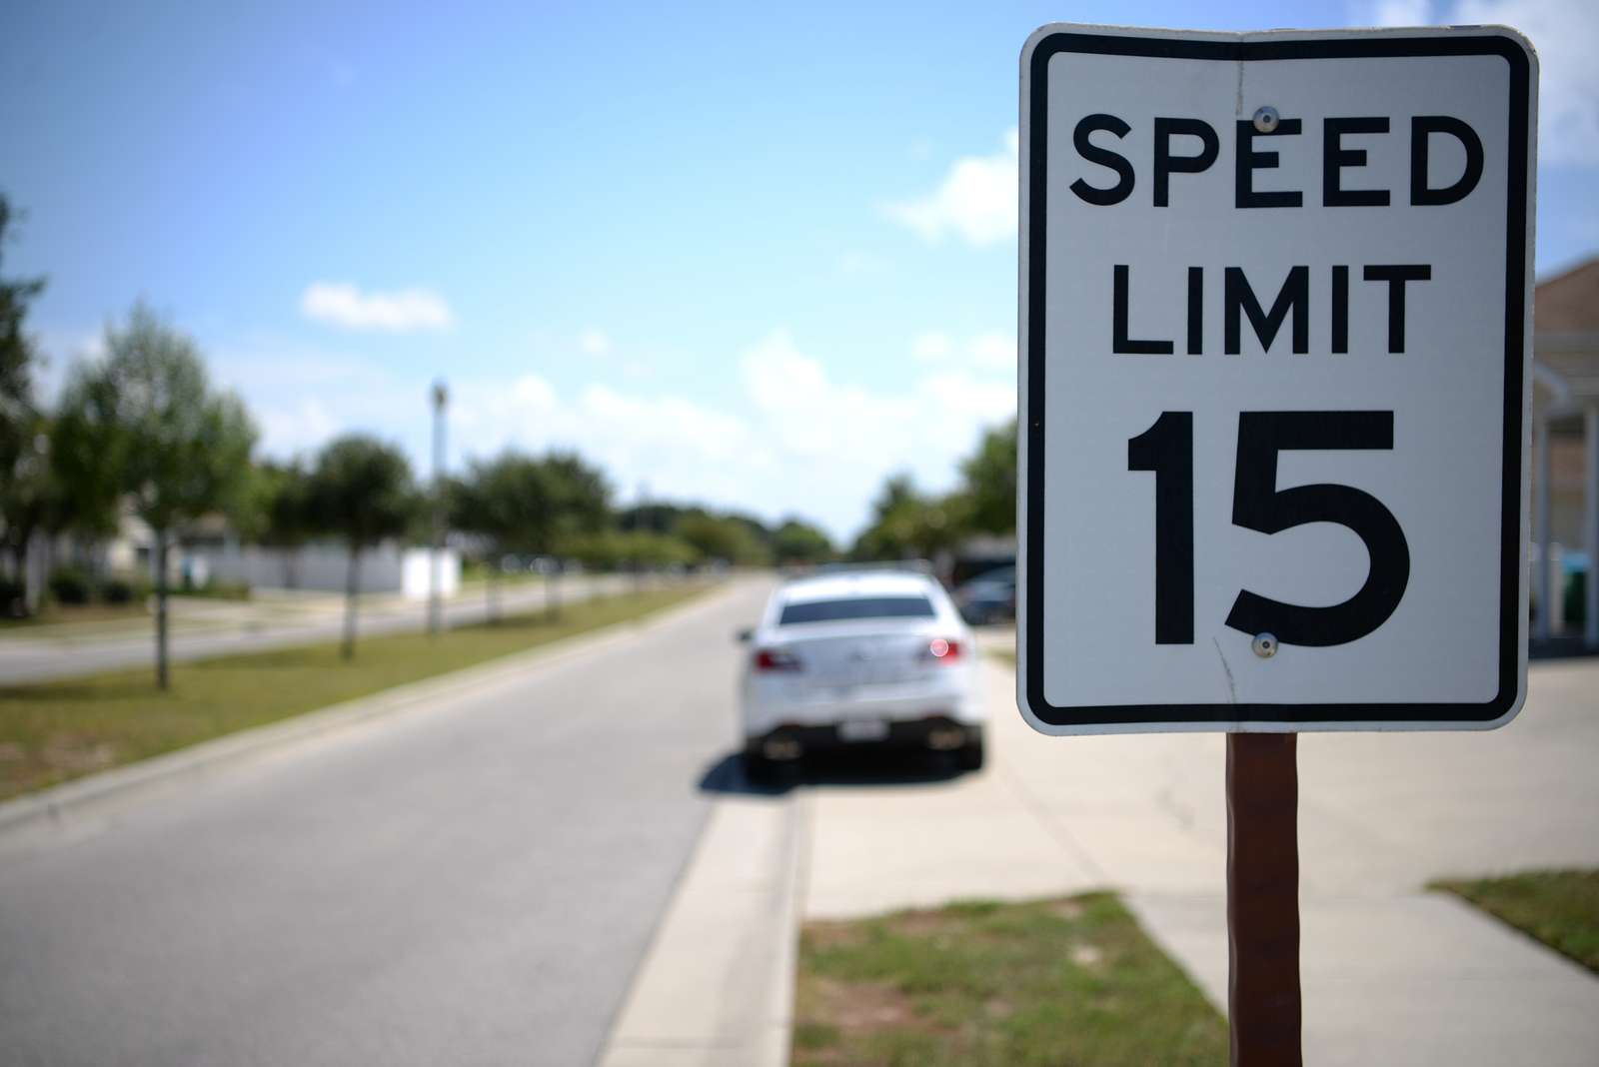
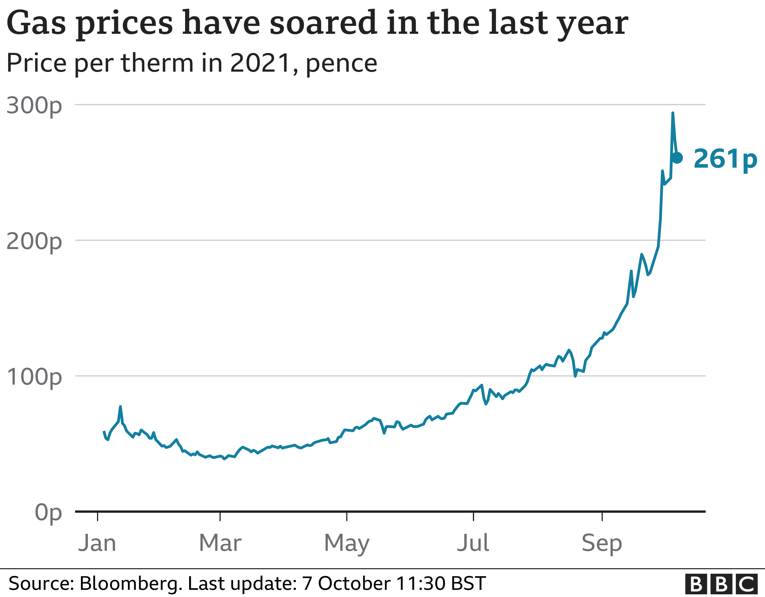
Introduction
Externally Switched Systems
The single microgrid is an example of an Externally Switched System.
Special class of hybrid systems:
State-based:
Time-based:
Switch in dynamics
Switch in constraints
Switch in objectives

Slide 5

Introduction
Externally Switched Systems
Objective: Find states that
Respect state constraints for current mode, and
Can respect state constraints for any possible new mode.
Consider constraints on the switching signals.
When can the
system switch?
Which modes can be switched between?

Slide 6
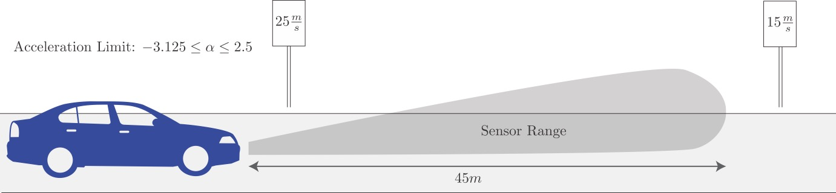
Introduction
Externally Switched Systems
Objective: Find states that
Respect state constraints for current mode, and
Can respect state constraints for any possible new mode.
Example: How fast can the car travel without violating switching speed limits?
Naive state constraints: 0 <= v <= 25 m/s
Safe-set state constraints: 0 <= v <= 22.5 m/s

Slide 7
Introduction
Externally Switched Systems
Objective: Find states that
Respect state constraints for current mode, and
Can respect state constraints for any possible new mode.

Slide 8
Introduction
Externally Switched Systems - Feasibility
Objective: Find states that
Respect state constraints for current mode, and
Can respect state constraints for any possible new mode.
Consider constraints on the switching signals described as directed graphs.
Example: mode sequence from node a:
1-1-1-3-3-2
Valid since path on graph exists!

Slide 9
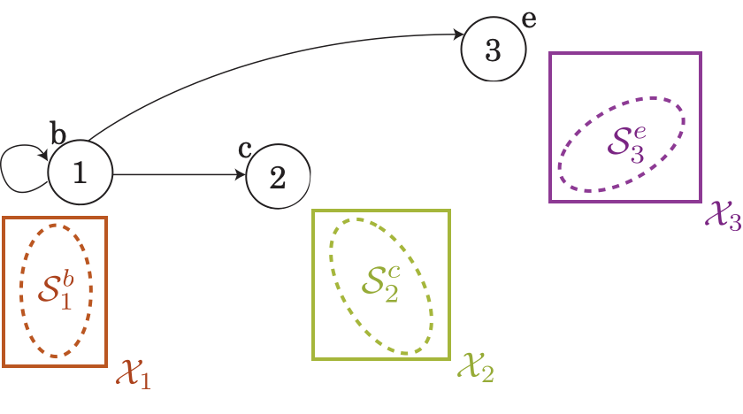
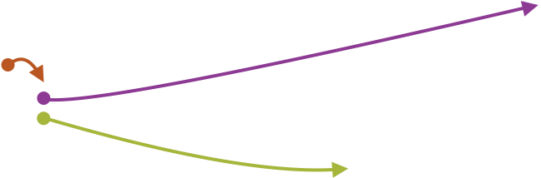
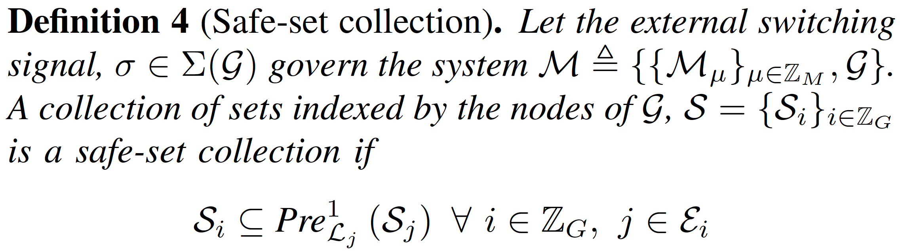
Introduction
Externally Switched Systems - Feasibility
Assign state constraints to each node.
Let inputs exist for every that will move the state into one of the successor sets depending on how the switching signal evolves.

Slide 10
Introduction
Externally Switched Systems - Feasibility
Algorithm

Slide 11
Introduction
Distributed Systems
Useful for making intractable problems tractable.
Two approaches:
Cooperative – work together for a global objective.
Non-cooperative – Work separately for local objectives.
Assumes a preview of disturbance, decreasing conservatism.
Add equations and Figure

Slide 12
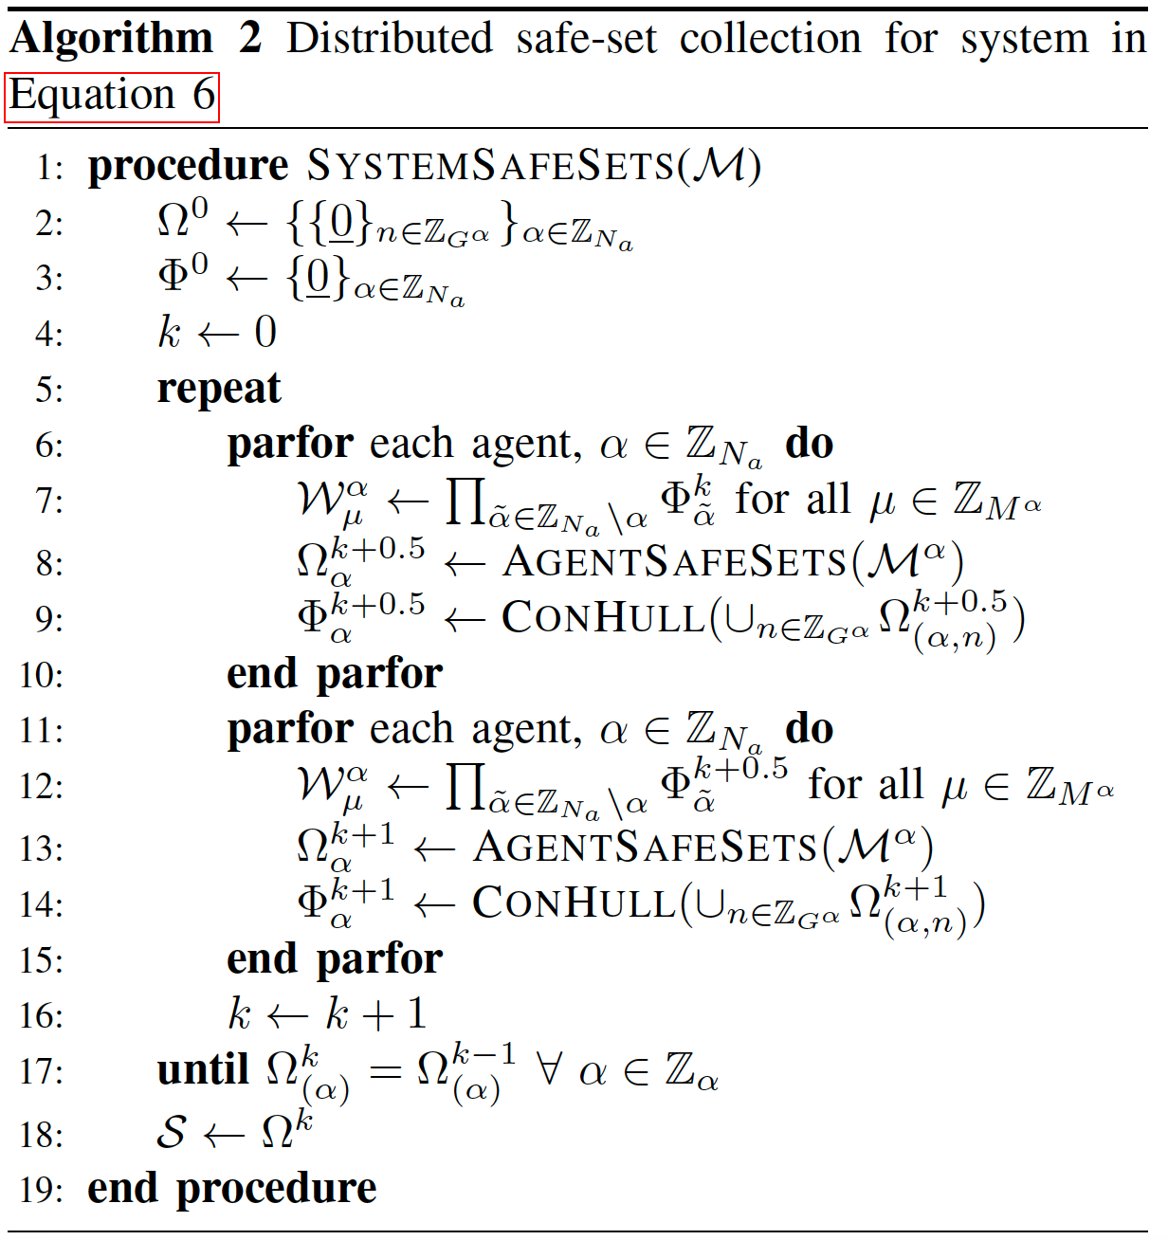
Solution Overview
Algorithm Design – Parallelized Algorithm
Start with trivial feasible regions (equilibrium points).

Slide 13
Solution Overview
Algorithm Design – Parallelized Algorithm
Start with trivial feasible regions (equilibrium points).
Compute safe-sets while assuming neighbors are using equilibrium points.

Slide 14
Solution Overview
Algorithm Design – Parallelized Algorithm
Start with trivial feasible regions (equilibrium points).
Compute safe-sets while assuming neighbors are using equilibrium points.
Share convex hull of new, larger safe-sets.

Slide 15
Solution Overview
Algorithm Design – Parallelized Algorithm
Start with trivial feasible regions (equilibrium points).
Compute safe-sets while assuming neighbors are using equilibrium points.
Share convex hull of new, larger safe-sets.
Recompute safe-sets with larger guesses for neighbors.

Slide 16
Solution Overview
Algorithm Design – Parallelized Algorithm
Provide supporting properties and lemmas

Slide 17
Numerical Example
Description
Coupled spring-mass-damper system with switching masses.

Slide 18
Numerical Example
Complexity
Centralized approach
Actual size would be orders of magnitude larger.
Approach | # Safe-Sets | Vertex/Safe-Set | Dim/Vertex | Bits/Dim

Slide 19
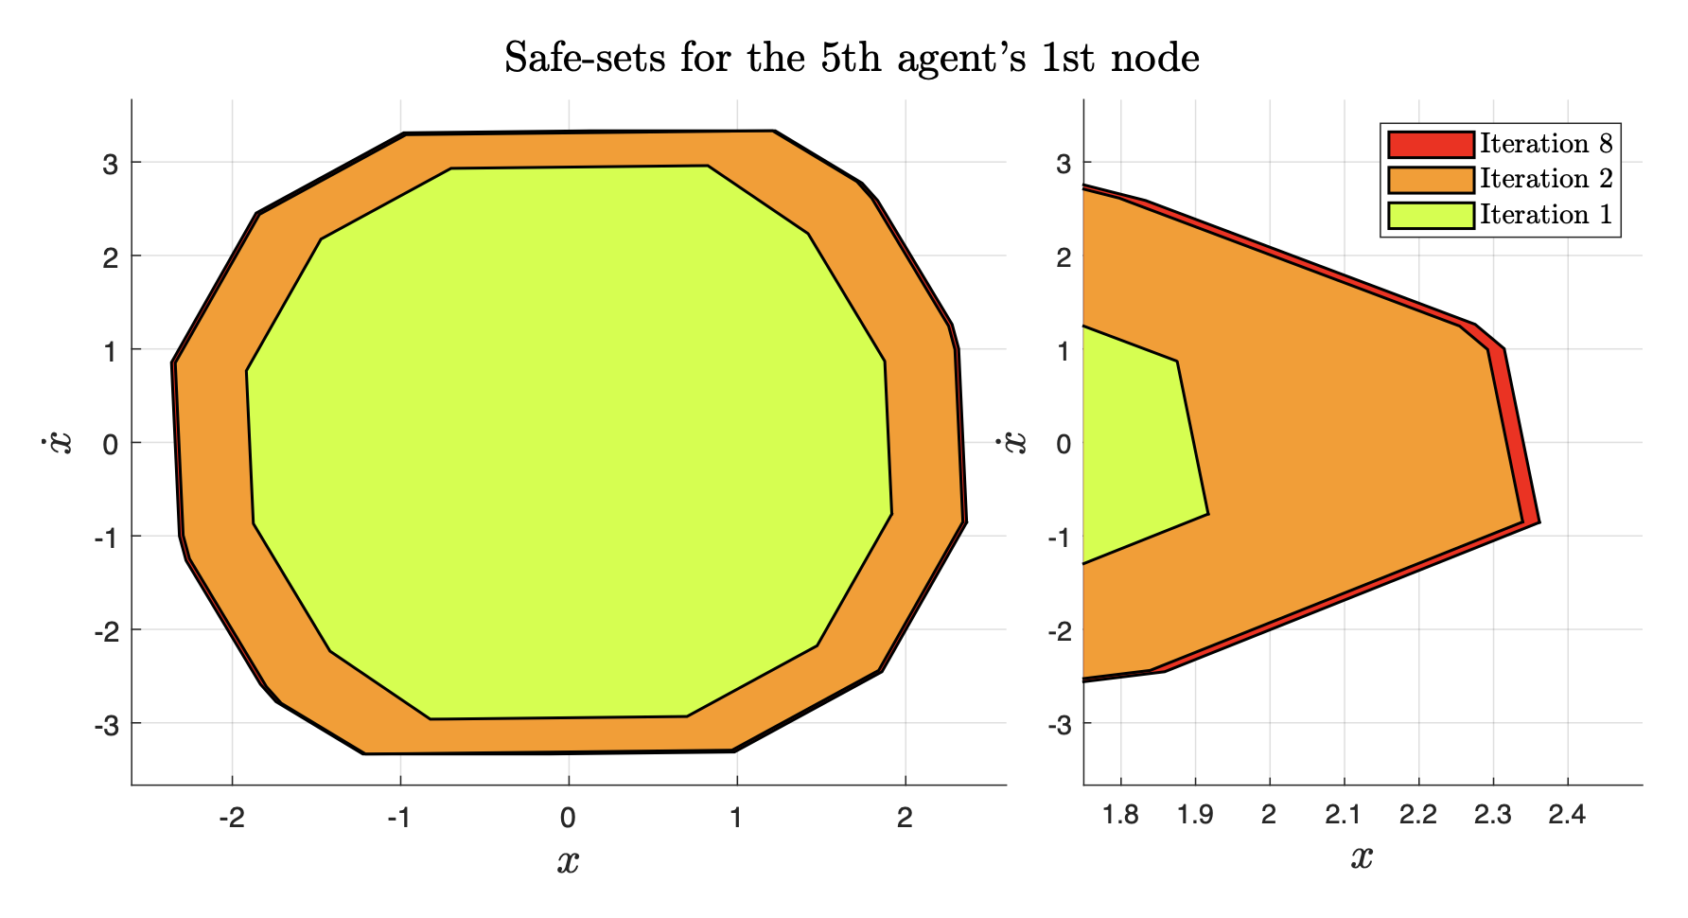
Numerical Example
Results
Computed using consumer PC

Slide 20
Conclusion
Summary of results
Future work

Slide 21
Questions?
Email: Richard.A.Hall@duke.edu

